Slide 1

Explanation-based constraint programming
Narendra Jussien
ナレンドラ・ジュシエン
École des Mines de Nantes 助教授
AFPC 理事長
Notes:
じょきょうじゅ
りじちょう

Slide 2
Outline
context
part 1 : explanations some definitions
part 2 : using explanations
part 3 : computation and implementations
general overview and current work

Slide 3
Context and origin
Dynamic constraint problems

Slide 4
Contexte
Programmation par contraintes ?
un carrefour
  mathématiques discrètes, intelligence artificielle, analyse numérique, recherche opérationnelle, calcul formel
des réussites marquantes
  ordonnancement, planification, logistique
  conception de circuit (simulation, synthèse, diagnostic)
  analyse financière (gestion de portefeuille)
  biologie (séquencement d’ADN, phylogénie)
un socle industriel
  deux éditeurs spécialisés : Ilog et Cosytec
  de grands groupes utilisateurs : Thalès, Bouygues, Air France, etc.

Slide 5
Contexte
Le cadre de la PPC
Problème de satisfaction de contraintes
  Variables (au sens mathématique)
  Domaines (valeurs possibles pour les variables)
  Contraintes (relations à vérifier entre variables)
Solution
  Affectation d’une valeur pour chaque variable permettant de satisfaire toutes les contraintes du problème
Objet de la programmation par contraintes
  Fournir les outils logiciels pour calculer une solution
Notes:
Signaler restriction ICI aux CSP discret mais tout est transposable aux CSP numériques

Slide 6
Contexte
Démarche générale de résolution
Principe général
  raffinement successif d’une solution partielle
Trois composantes
  Propagation/filtrage : élimination a priori de portions inadéquates de l’espace de recherche
  Extension : comment étendre la solution partielle courante
  Remise en cause : comment réparer l’affectation partielle courante contradictoire

Slide 7
Contexte
Deux points remarquables
Propagation
  propagation locale à chaque contrainte
  communication inter-contraintes via les variables
  notion d’événements, de file de propagation, etc.
Notion de contrainte globale
  une solution éprouvée pour un sous-problème récurrent
  ménagerie importante existante
  une des forces de la programmation par contraintes

Slide 8
Contexte
Quelques propriétés
Déclarativité
  l’utilisateur spécifie le quoi
  le solveur de contraintes s’occupe du comment
Généricité
  pas de restriction à un problème particulier
Adaptabilité et réutilisabilité
  prise en compte de contraintes hétérogènes
  un composant pour un outil de résolution
    approches hybrides

Slide 9
Context
Dynamic problems
Application domains
  Online planning, mission planning
  Interactive / distributed solving
  Debugging, analysis
Evolving problem structure
  Adding/removing constraints
  Before / While / After solving
Key points
  Avoiding re-computation (or being as efficient as possible)
  Avoiding radical changes between consecutive solutions

Slide 10
Part 1 explanations

Slide 11
PhD thesis (97)
Dynamic problems
Main difficulties
  Incremental constraint removal
    How undoing past effects with no from scratch re-computation?
  Avoiding « thrashing » phenomena
    Avoiding already explored situations
  Handling over-constrained problems
    What if too many constraints are added?
A unique tool: event explanations
  Subset of constraints whose conjunction leads to a given event: value removal, contradiction, constraint addition, etc.

Slide 12
Example
C₁
1 2 3
X
C1 : X > Y
C2 : Y > Z
Z
Y
1 2 3
1 2 3
C₁ & C₂
C₁ & C₂
C₂
C₁
C₂
Recording an explanation for each event

Slide 13
Beware!
Explanations vs. (A)TMS
  (A)TMS = set(s) of hypothesis justifying some reasoning
  Explanations = (A)TMS “light”
Explanations vs. nogoods
  Nogood : globally inconsistent partial assignment
  Explanation = “justified” nogood
    Set of constraints justifying inconstencies
Explanations vs. “explanations” [Ilog version ☺]
  Ilog = locally inconsistent set of constraints
    also called “conflict sets”
  here = globally inconsistent set of constraints

Slide 14
PhD thesis conclusions
Explanations are interesting
Overcoming difficulties
  Direct access to past effects of a constraint
    Events justified by any explanation containing the given constraint
  Avoiding “thrashing”
    Explanations as a compact and generic information about situations to be avoided
  Handling over-constrained problems
    Focusing on constraints really responsible for the contradiction
    Using incremental removal
Notes:
Sur le transparent suivant, signaler que

Slide 15
Part 2
Using explanations
Solving dynamic problems
Analyzing and debugging constraints
Defining new solving techniques

Slide 16
Explanations for dynamic problems
Theoretical aspects
Practical applications
Notes:
Lien formel avec le modèle de résolution

Slide 17
Explanations for dynamic problems
Theoretical aspects [FLAIRS’03]
Relation between explanations and theoretical models for solving constraint problems
  Proof-tree
    Relation between explanations and propagation rules
      Explanation = constraints appearing in a “logical” chain of rules
A formal viewpoint for constraint removal
  Undoing past effects of a given constraint
    Formal definition of the set of events to be undone
  Constraint re-propagation
    Formal characterization of constraints (rules) to be re-propagated
Interests
  Simplified proofs for dynamic constraint removal algorithms
    AC|DC, DnAC4, DnAC6, …
  A unique definition for both formal and operational aspects
Notes:
Gains d’Abdallah : de 30 à 100% mais on peut perdre du temps. Rappeler complexité identique mais dire que sur le long terme semble converger vers gains …

Slide 18
Explanations for dynamic problems
Applications
Dynamic scheduling problems
  Shop scheduling problems
    The RIO system
  Renewable resources scheduling problems [PATAT’02]
    Dynamic RCPSP : Abdallah Elkhyari’s PhD thesis (2003)
Timetabling problems (EMN)
  Week-scheduling taking into account individual student’s choices, teacher’s constraints, incompatibilities
  Automated solving and simulation
    From one week to less than one minute for solving the problem
    Simulation tool for the planner
  Student work [PATAT’04]

Slide 19
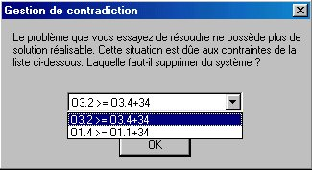
Explanations for dynamic problems
Difficulties
Tools for analysis and simulation
  Providing information to the user ?
  How using explanation to help understanding the situation ?
  What simulation tools ?
Explanations for global constraints

Slide 20
Explanations for analysis, debugging, and simulation
Providing information to the user

Slide 21
Analysis / Debugging / Simulation
Using explanations
Explaining contradictions
  Look at the explanation
Explaining why the expected solution is not present
  Explanation for value removals
New simulation tools for constraints addition/removal : reusing past work ?
  Recording past explanations (only “relevant” ones)
Explaining “no response”: where is the bottleneck ?
  Analyzing the explanation network
    Dynamic links between constraints (through propagation)

Slide 22
Analysis / Debugging / Simulation
User interaction
The user’s point of view
  High level of abstraction, problem-related concepts
The solver’s point of view
  Low level constraints: X₂₅₀ > Y₂₄₀ + 4
  Problem-related concepts invisible
The explanation’s point of view
  Currently: low level constraints

Slide 23
Analysis / Debugging / Simulation
User interaction [WS ICLP’01]
Conference
Talks
Options
Integrity
projection
Not day 4
No simult.
MP ≠ AM
MP ≠ 4
MP ≠ MA

Slide 24
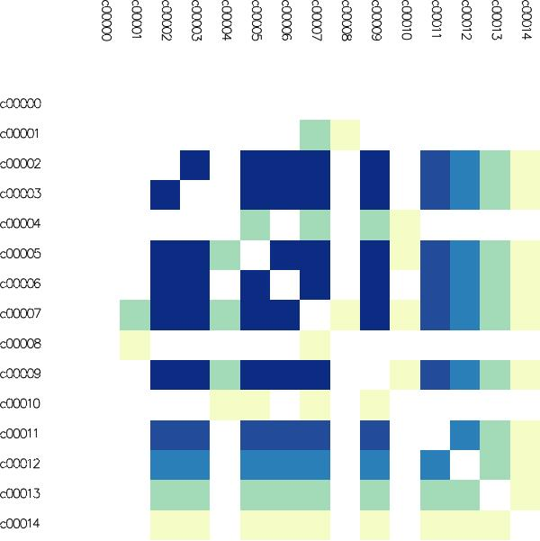
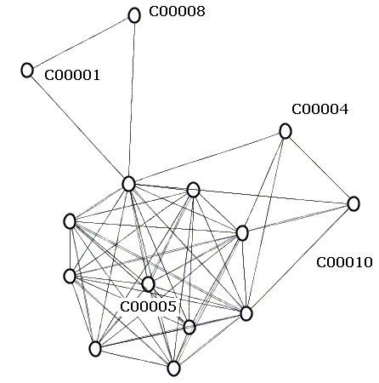
Analysis / Debugging / Simulation
Vizualizing explanations [FLAIRS’04,SOFTVIS’05]
Establishing links between variables and constraints through explanations
Dynamic vs. static structure of the problem
Matrix representation

Slide 25
Explanations and new solving techniques

Slide 26

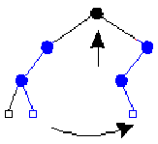
Explanations and new solving techniques
Foundations [ILPS’97]
[mac (pb: Problem) : void
-> while UnInstantiatedVars not empty (
try (
enumerate(pb),
propagate(pb)
)
catch contradiction (
backtrack(pb)
)
)]
-dbt
variable choice,
value choice
Analyzing failure causes (explanations)
Replace backtracking with repair

Slide 27
Explanations and new solving techniques
New algorithms
MAC-DBT [CP’00]
  Combining constraint propagation and dynamic backtracking [Ginsberg, 93]
  Important improvements for structured problems
  Improved stability
Dynamic Domain Splitting [ECAI’98]
  MAC-DBT applied to numeric CSP
  First algorithm for solving dynamic numeric CSP
13
14
2
3
8
9
1
4
7
10
6
5
12
11

Slide 28
Explanations and new solving techniques
New algorithms
Decision-repair [AIJ’02]
  An original combination
    Local search (on decisions)
    Constraint propagation (partial assignments)
  Application: open-shop scheduling
    Highly competitive compared to ad-hoc techniques
      Taillard and Brucker’s instances
    Open instances solved for the first time
      Guéret and Prins’s hard instances
    Important stability improvement
Notes:
Dire ici que ça donne plus de libertés pour réparation et décisions à prendre

Slide 29
Explanations and new solving techniques
A general framework [MIC’03]
PLM ( V, C, CD )
Pb := ( V, C, CD )
repeat
Pb := filter(Pb)
switch check(Pb)
one solution : return Pb
no solution : Pb := forget(repair(record(Pb)))
otherwise : Pb := extend(Pb)
endswitch
until termination
Propagate, Learn, Move (exploration)
Complete (SB, CBJ, MAC-DBT, etc.) and incomplete instances (decision-repair, tabu, etc.)
Notes:
Préciser qu’on ne se limite pas aux explications

Slide 30
Explanations and new solving techniques
Challenges
Problems
  First applications: open-shop, RCPSP, timetabling
  Testing other (structured) problems
Combinations
  Other PLM instances
  New values for the components
Software tools
  Providing tools to combine components
  A first answer: PaLM
    part of the choco constraint solver
      http://choco.sf.net

Slide 31

A first overview
user / developper
analysis aid
model
yes
no
infinite waiting
modifications
stability / efficiency
constraint solver
incrementality
information
new approaches

Slide 32
Part 3
Computation and implementations
Computing explanations
Spreading the news

Slide 33
Computing explanations
Different techniques
a posteriori computation [Junker, 01]
  Minimal explanation
  Significant time overhead
  Information about the resolution is lost
a priori computation [Sqalli, 96; Amilhastre, 02]
  Problem pre-compilation
  Instantaneous response times
  All possible requests need to be foreseen
on the fly computation
  Pragmatic approach

Slide 34
Computing explanations
A pragmatic approach
Using the “embedded” knowledge
  An explicit trace of the behavior of the solver
No minimality guaranteed
  Hypothesis
    efficient/quick solver = “good” explanations
Overhead due to computation and storage
  Usage overcomes this overhead

Slide 35
Computing explanations
A real difficulty: global constraints
“Design patterns” of CP
  An efficient solution for a recurrent sub-problem
    Generalized differences: allDifferent
    Renewable resources: cumulative
    Regulation constraints: stretch
Main interests
    Modeling
    Stability / efficiency
Notes:
Problème = ensemble de propriétés (sur un graphe)
Synthèse et composition = ensemble de contraintes globales
Résolution améliorée (efficacité)

Slide 36
Computing explanations
Back to the example
C₁
1 2 3
X
C1 : X > Y
C2 : Y > Z
Z
Y
1 2 3
1 2 3
C₁ & C₂
C₂
C₁

Slide 37
Explanations for global constraints
An example: allDifferent
1,1 0,1
0,1
A
1
A
1
[1,2]
A
C
[1,2,3,4]
X
X
B
2
B
2
S
T
C
3
C
3
[1,2]
B
D
[1,2,3,4]
X
X
D
4
D
4
Explanation = value in ancestors
removed from descendent variables
SCC
A
1
SCC
B
2
What about explanations ?
S
T
C
3
SCC
D
4
SCC

Slide 38
Explanations for global constraints
Learning from the experience
When facing complex algorithms
  Theoretical study of the algorithm
  Production of an efficient algorithm for both propagation and explanation computation
Existing instrumented constraints
  Unary resources: immediate selections and task intervals
  N-ary resources: histogram, core-times
  Flow–based constraints: allDiff., GCC, flow [UICS’03]
  Regulation-based constraints: stretch
Automated generation
  Using a catalog of explained properties

Slide 39
Implementations
“Spreading the news”
A contribution to the “constraints” technology
Providing integrated tools
  Several implementations
    94/97 : Relax(FD) – scheme, claire
    98/99 : DECorum – bibliothèque C++ library
    00/03 : PaLM V1, V2, V3 –choco/claire library
    04 : JPaLM–JChoco/Java package
  There are users (event not from Nantes ☺)
    Newcomers are welcome (cf. timetabling problem)
    Forums (cf. www.e-constraints.net)
Providing external tools

Slide 40
Spreading the news: a non intrusive approach
An explanation “service” for constraint solvers
Issues
  Producing explanation from the outside
  Nevertheless providing a single executable
solver
explained
solver
explanations
Notes:
Faire l’analogie avec des personnes à citer ICI ou A LA FIN !

Slide 41
A non intrusive solution
Aspect oriented programming
Aim
  Expressing transverse functionalities as single modules (explanations, caching, billing, etc.)
Aspect oriented programming (AOP)
  A decomposition language (transverse)
  Code weaver
Beyond explanations
  Aspects for other solver services
    Eg: local search
  An aspect-oriented language for CP

Slide 42
General overview and future (current) work
Several point of views
Future work

Slide 43
Main contributions
Theoretical advances on explanations
  Clarified definitions, etc.
Dynamic problems handling
  The operational dimension of explanations: a compromise between time overhead and improvements
Search algorithms improvements
  Cross-cutting propagation and local search
    MAC-DBT => decision-repair => PLM
New results on open-shop scheduling
  A more stable approach
  Closed instances
Analysis and debugging tools
An available integrated system: PaLM

Slide 44
About “explanations”
From theory …
  Theoretical fundations for explanations
  A “practical” theory
  Several computation approaches studied
… to practice
  Interaction tools
  New search techniques
  Implementations
External impact
  Teaching / Spreading “constraints”
  A general trend: from the black box to the glass box
  Other research groups, other techniques

Slide 45
Several fields
Artificial Intelligence
  Discrete and numeric CSP
  Combining propagation and intelligent backtracking
  Relations between local search and propagation
Operations research
  Shop scheduling (Open-Shop)
  Resource scheduling (dynamic RCPSP)
  Timetabling problems
  Flow problems
Software engineering
  Explanation-based solver implementation
  Constraints and AOP
  Tools for software development (PTIDEJ) [ASE01]

Slide 46
Financement des explications
Financements « amont »
  RNTL OADYMPPAC 2000—2003
    Outils d’Analyse Dynamique et de Mise au Point de Programmes avec Contraintes
Financements pour des prototypes
  CRITT Productique 1999
    Développement de DECorum
    Aspects relation avec l’utilisateur
  ANVAR 2000—2001
    Prototype RIO (Résolution Interactive de problèmes d’Ordonnancement)
Études ponctuelles
  Bouygues 2003
    Explications pour une contrainte de maintien de flot compatible

Slide 47
Future work
Three main topics
  Explanation and global constraints
    Towards a “universal” system
  New search techniques
    Convice people that explanations are “essential”
  CP and AOP
    Towards real “programming”
New possibilities
  Interfacing solvers
    Constraints to solver knowledge sharing
  Learning techniques for constraint solvers
    Improving filtering using gathered information
Notes:
Parler de réglage de paramètres …

Slide 48
General perspectives
Dynamic problems
  Robustness and stability
  Specific extensions (scheduling, online systems)
  Practical validation
Complex systems
  Distributed, collaborative, uncertain environment
  Multi-objective techniques, probabilistic algorithms, etc.

Slide 49
Générique
Vincent Barichard, Angers
  PaLM pour contraintes en extension
Patrice Boizumault, Caen
  Relaxation dynamique, relations utilisateurs
Philippe David, EMN
  Emploi du temps EMN, le nom PaLM
Romuald Debruyne, EMN
  MAC-DBT, aspects théoriques
Rémi Douence, EMN
  Aspects et contraintes
Abdallah Elkhyari, EMN
  RCPSP dynamique
Jean-Daniel Fekete, INRIA Mohammad Ghoniem, EMN
  Visualisation
Gérard Ferrand, Willy Lesaint, Alexandre Tessier, Orléans
  Aspects théoriques
Yann-Gaël Guéhéneuc, Montréal
  Explications pour le génie logiciel
Christelle Guéret, EMN
  Open-shop, RCPSP dynamique, … Keva
François Laburthe, Bouygues
  allDifferent expliqué, PaLM, …
Olivier Lhomme, Ilog
  Dynamic domain splitting, decision-repair, PLM, relations utilisateur, …
Groupe OCRE
  PaLM
Samir Ouis, EMN
  Relations utilisateur, pertinence des explications, aspects théoriques
Guillaume Rochart, EMN
  Explications pour les contraintes globales, JPalm

